Slide 1

Data Science
for Business

Slide 2

Natural language processing can be used to build predictive models to perform sentiment analysis on social media posts and reviews and predict if customers are happy or not.
Natural language processors work by converting words into numbers and training a machine learning models to make predictions.
That way, you can automatically know if your customers are happy or not without manually going through massive number of tweets or reviews!

Slide 3
You work as a data scientist at a multinational corporation.
The Public relations department team has collected extensive data on their customers such as product reviews.
Based on the reviews ( in text format), the team would like to predict whether their customers are satisfied with the product or not.

Slide 4
TOKENIZATION (COUNT VECTORIZER)
This is the first document.
This document is the second document.
And this is the third one.
Is this the first document?
[[0 1 1 1 0 0 1 0 1]
[0 2 0 1 0 1 1 0 1]
[1 0 0 1 1 0 1 1 1]
[0 1 1 1 0 0 1 0 1]]
 | 'and' | 'document' | 'first' | 'is' | 'one' | 'second' | 'the' | 'third' | 'this'
Training Sample #1 | 0 | 1 | 1 | 1 | 0 | 0 | 1 | 0 | 1
Training Sample #2 | 0 | 2 | 0 | 1 | 0 | 1 | 1 | 0 | 1
Training Sample #3 | 1 | 0 | 0 | 1 | 1 | 0 | 1 | 1 | 1
Training Sample #4 | 0 | 1 | 1 | 1 | 0 | 0 | 1 | 0 | 1

Slide 5
NAÏVE BAYES: INTUITION
Naïve Bayes is a classification technique based on Bayes’ Theorem.
Let’s assume that you are data scientist working major bank in NYC and you want to classify a new client as eligible to retire or not.
Customer features are his/her age and salary.
CLASS 1: RETIRE
40 BLUE POINTS
NEW CUSTOMER
FEATURE #2: SAVINGS
?
CLASS 0: NO RETIRE
20 RED POINTS
FEATURE #1: AGE

Slide 6
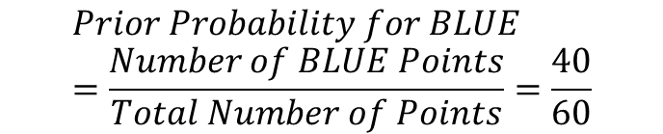
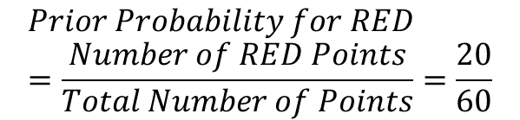
NAÏVE BAYES: 1. PRIOR PROBABILITY
Points can be classified as RED or BLUE and our task is to classify a new point to RED or BLUE.
Prior Probability: Since we have more BLUE compared to RED, we can assume that our new point is twice as likely to be BLUE than RED.
$$Prior Probability for RED=\frac{Number of RED Points}{Total Number of Points}=\frac{20}{60}$$
CLASS 1: RETIRE
40 BLUE POINTS
$$Prior Probability for BLUE=\frac{Number of BLUE Points}{Total Number of Points}=\frac{40}{60}$$
FEATURE #2: SAVINGS
?
CLASS 0: NO RETIRE
20 RED POINTS
FEATURE #1: AGE

Slide 7
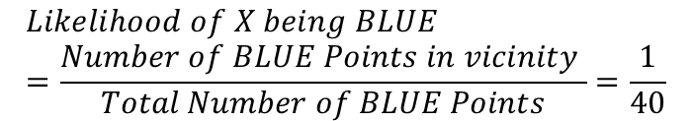
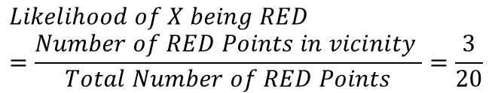
NAÏVE BAYES: 2. LIKELIHOOD
For the new point, if there are more BLUE points in its vicinity, it is more likely that the new point will be classified as BLUE.
So we draw a circle around the point
Then we calculate the number of points in the circle belonging to each class label.
40 BLUE POINTS
$$Likelihood of X being RED=\frac{Number of RED Points in vicinity }{Total Number of RED Points}=\frac{3}{20}$$
$$Likelihood of X being BLUE=\frac{Number of BLUE Points in vicinity }{Total Number of BLUE Points}=\frac{1}{40}$$
FEATURE #2: SAVINGS
?
20 RED POINTS
FEATURE #1: AGE

Slide 8

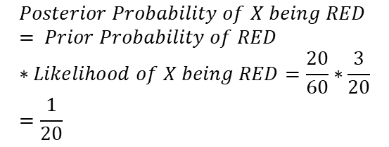
NAÏVE BAYES: 3. POSTERIOR PROBABILITY
Let’s combine prior probability and likelihood to create a posterior probability.
Prior probabilities: suggests that X may be classified as BLUE Because there are twice as much blue points.
Likelihood: suggests that X is RED because there are more RED points in the vicinity of X.
Bayes’ Rule combines both to form a posterior probability.
$$Posterior Probability of X being RED= Prior Probability of RED ∗Likelihood of X being RED=\frac{20}{60}∗\frac{3}{20}=\frac{1}{20}$$
40 BLUE POINTS
FEATURE #2: SAVINGS
$$Posterior Probability of X being BLUE= Prior Probability of BLUE∗Likelihood of X being BLUE=\frac{40}{60}∗\frac{1}{40}=\frac{1}{60}$$
?
X CLASSIFIED AS RED (NON RETIRING) SINCE IT HAS LARGER POSTERIOR PROBABILITY
20 RED POINTS
FEATURE #1: AGE

Slide 9


NAÏVE BAYES: SOME MATH!
PRIOR PROBABILITY OF RETIRING
LIKELIHOOD
$$P\left(Retire\right|X)=\frac{P\left(X | Retire\right)∗P(Retire)}{P(X) }$$
MARGINAL LIKELIHOOD
Naïve Bayes is a classification technique based on Bayes’ Theorem.
$X$: New Customer’s features; age and savings
$P\left(Retire\right|X)$: probability of customer retiring given his/her features, such as age and savings
$P(Retire)$: Prior probability of retiring, without any prior knowledge
$P(X|Retire)$: likelihood
$P(X)$: Marginal likelihood, the probability of any point added lies into the circle

Slide 10

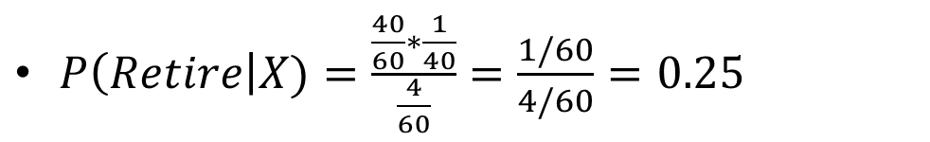
NAÏVE BAYES: SOME MATH!
PRIOR PROBABILITY OF RETIRING
LIKELIHOOD
$$P\left(Retire\right|X)=\frac{P\left(X | Retire\right)∗P(Retire)}{P(X) }$$
MARGINAL LIKELIHOOD
$P\left(Retire\right)=\frac{\# of Retiring}{Total points}= 40/60$
$P\left(X | Retire\right)=\frac{\# of smilar observations for retiring}{Total \# retiring}=1/40$
$P\left(X\right)=\frac{\# of Similar observations}{Total \# Points}=4/60$
$P\left(Retire\right|X)=\frac{\frac{40}{60}∗\frac{1}{40}}{\frac{4}{60}}=\frac{1/60}{4/60}=0.25$

Slide 11
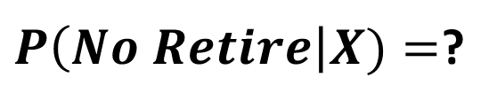
NAÏVE BAYES: QUIZ/CALCULATE THE PROBABILTY OT NON-RETIRING (RED CLASS)
$P\left(No Retire\right|X)=$?

Slide 12

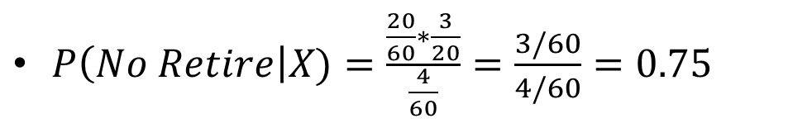
NAÏVE BAYES: QUIZ/CALCULATE THE PROBABILTY OT NON-RETIRING (RED CLASS)
PRIOR PROBABILITY OF NO RETIRING
CLASS 1: RETIRE
LIKELIHOOD
40 BLUE POINTS
$$P\left(No Retire\right|X)=\frac{P\left(X | No Retire\right)∗P(No Retire)}{P(X) }$$
FEATURE #2: SAVINGS
MARGINAL LIKELIHOOD
$P\left(No Retire\right)=\frac{\# of No Retiring}{Total points}=20/60$
$P\left(X | No Retire\right)=\frac{\# of smilar observations for No retiring}{Total \# no retiring}=3/20$
?
$P\left(X\right)=\frac{\# of Similar observations}{Total \# Points}=4/60$
CLASS 0: NO RETIRE
$P\left(No Retire\right|X)=\frac{\frac{20}{60}∗\frac{3}{20}}{\frac{4}{60}}=\frac{3/60}{4/60}=0.75$
20 RED POINTS
FEATURE #1: AGE
$$NOTE: P\left(Non Retire\right|X)=1−0.25=0.75$$

Slide 13
CONFUSION MATRIX
TRUE CLASS
+
-
TYPE I ERROR
+
TRUE +
FALSE +
PREDICTIONS
FALSE -
TRUE -
-
TYPE II ERROR

